Slide 1

Finding similarity and grouping Neighborhoods in Toronto city

Slide 2
find a place of your choice in a city
Generally. people have been moving around to the world for one reason or the other.
They need to select a place where they can buy new house.
To know the neighborhood
several factors in mind
make it easy for the people to decide which neighborhood to choose

Slide 3
Data acquisition and Cleansing
neighborhood along with their postal codes has been collected from Wikipedia page:‘https://en.wikipedia.org/w/index.phptitle=List_of_postal_codes_of_Canada:_M&oldid=1011037969'
Longitude and Latitude of each neighborhood has been gathered from 'https://cocl.us/Geospatial_data'
The data about the venues is collected using the Foursquare API.
Venues with top 10 mean were selected as features

Slide 4
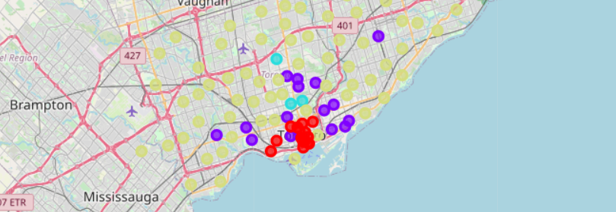
Model and Results
DBSCAN has been used for clustering similar Neighbours and it results in 4 groups.

Slide 5
Conclusion and future work
To group neighborhoods in the city, the similarity is measured using DBSCAN based on the venue's information gathered through Foursquare API.
Some important features such as housing cost, crime rate in the area and more needs to be added in the features.
A list of features can be used so that user can select features of his choice to find a neighborhood.

